Slide 1

The journey to create a data product

Slide 2
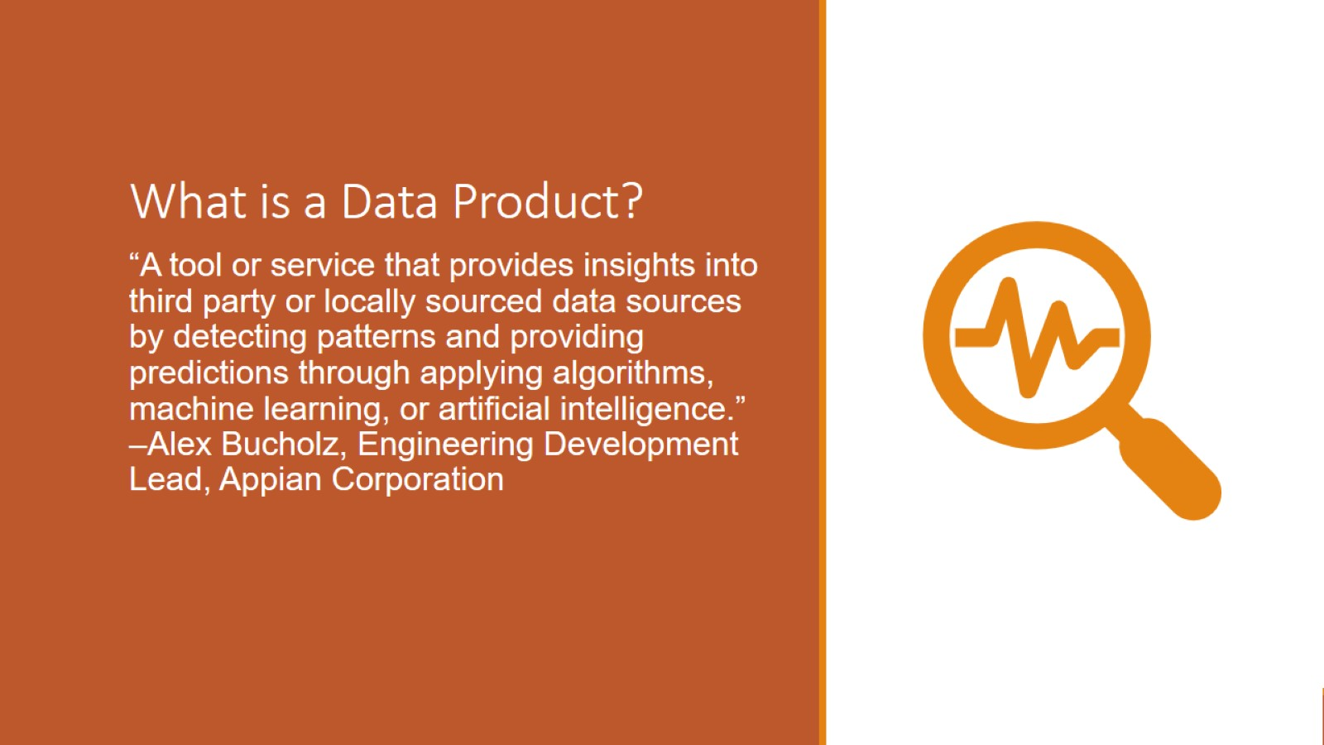
What is a Data Product?

Slide 3
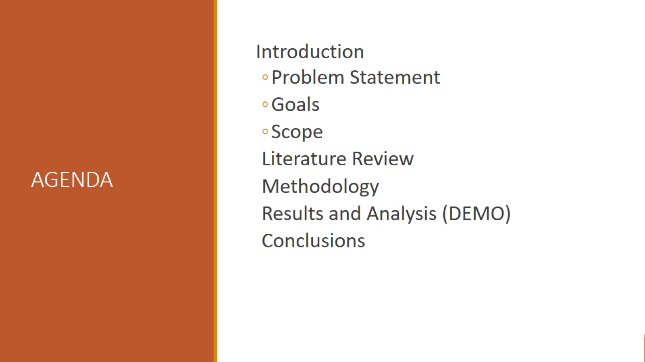
AGENDA

Slide 4
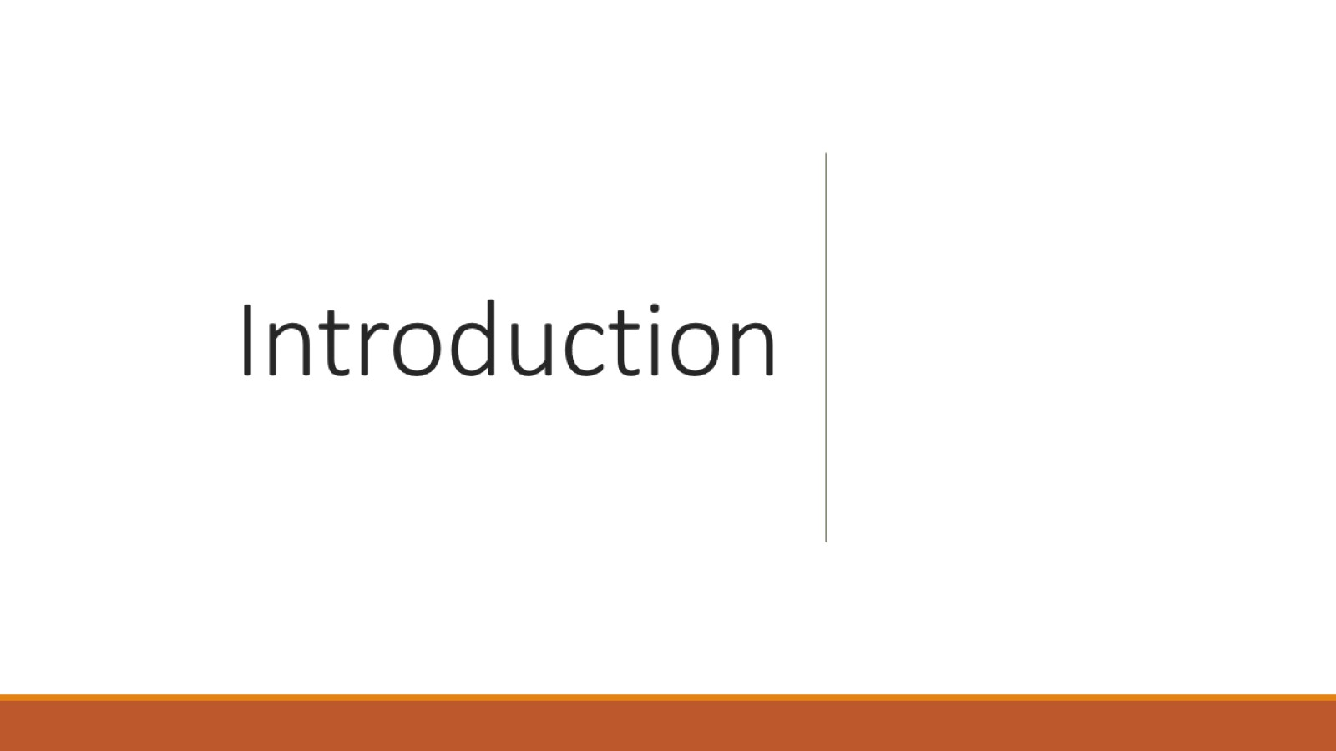
Introduction

Slide 5
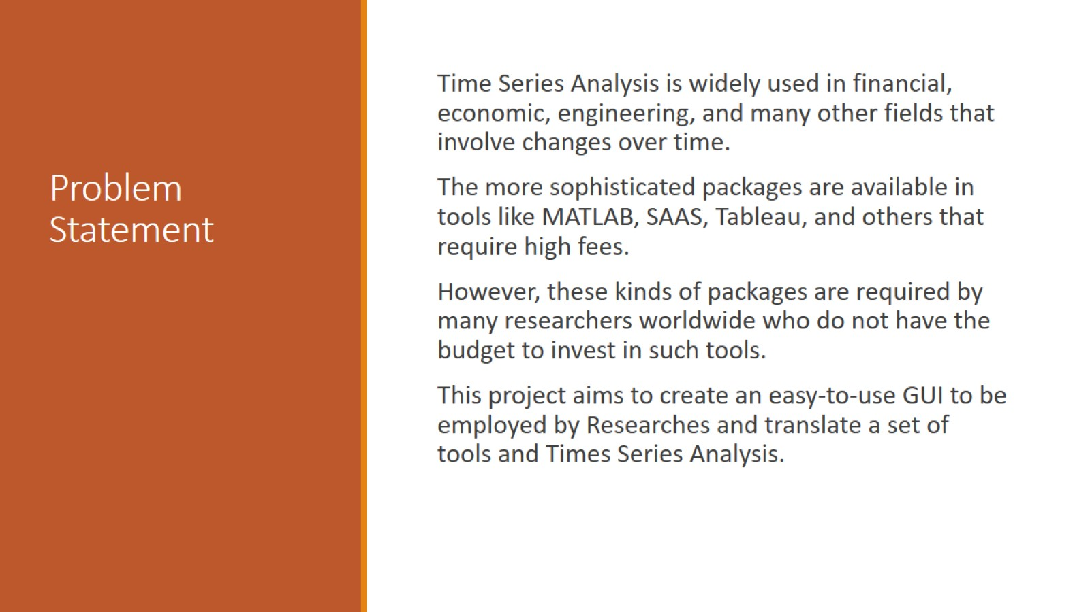
Problem Statement

Slide 6
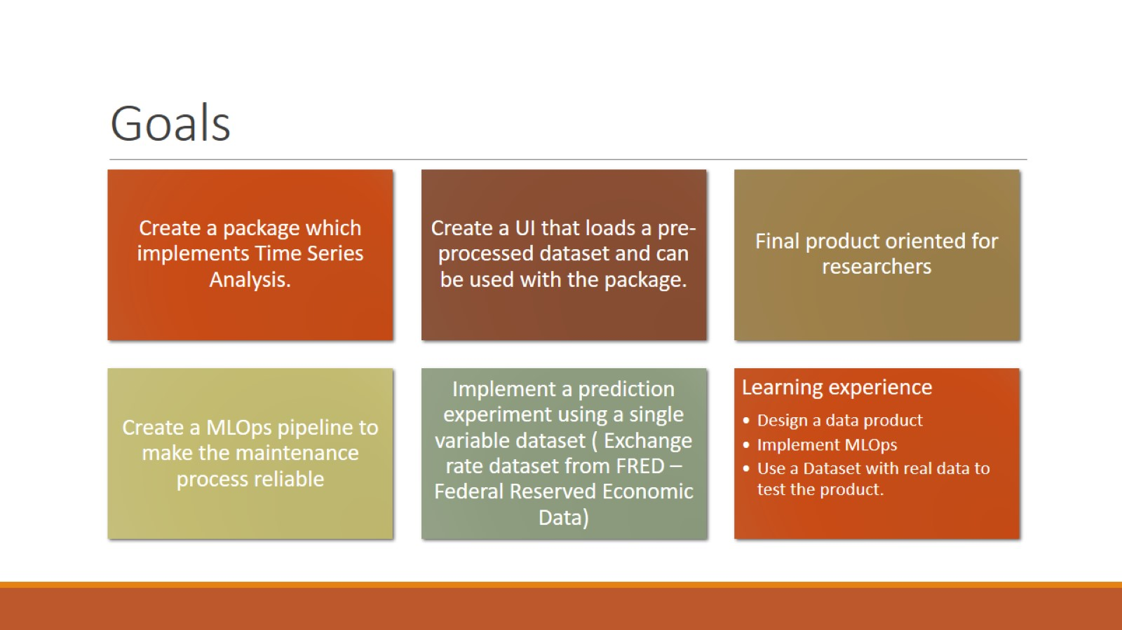
Goals

Slide 7
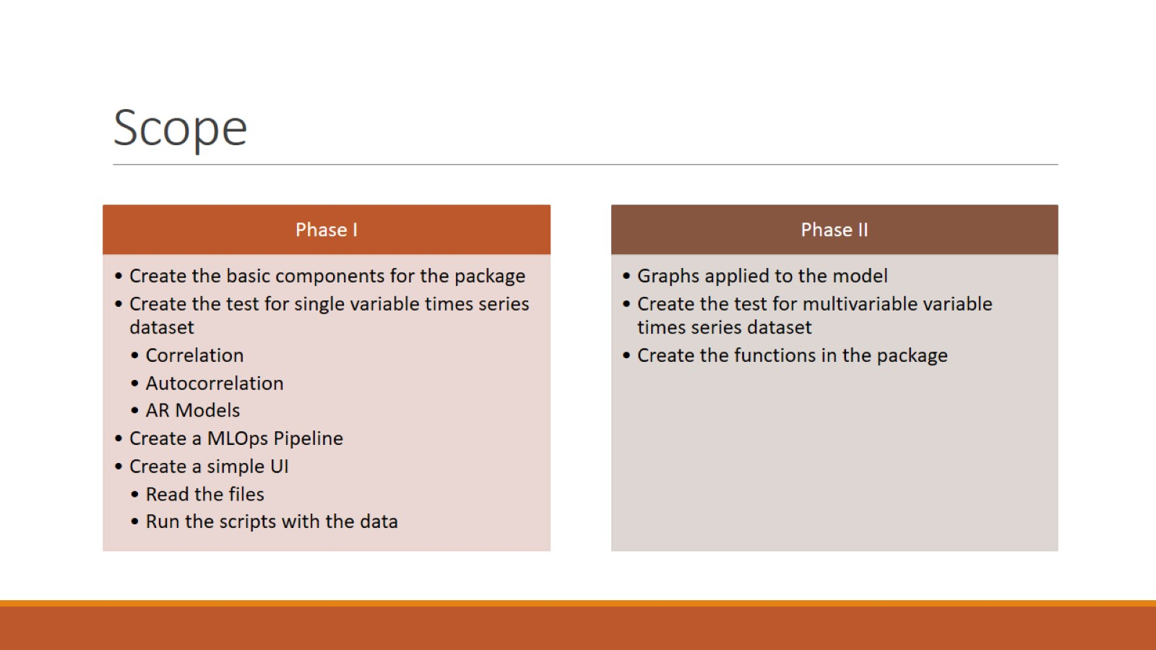
Scope

Slide 8
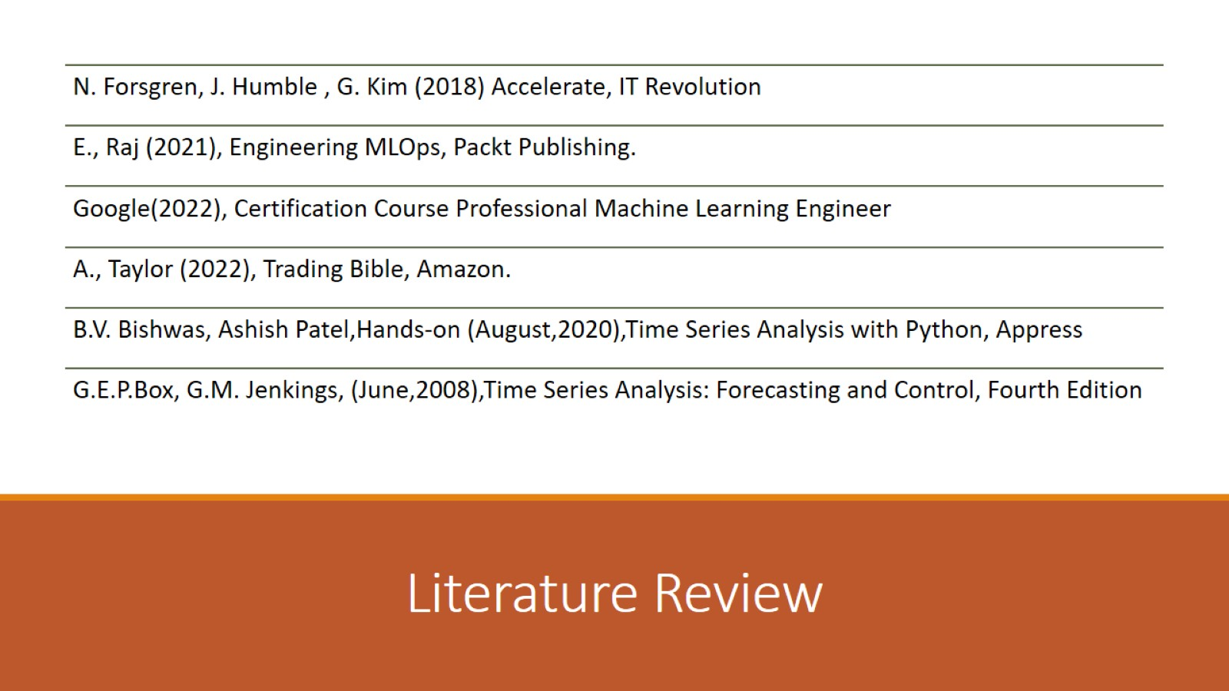
Literature Review

Slide 9
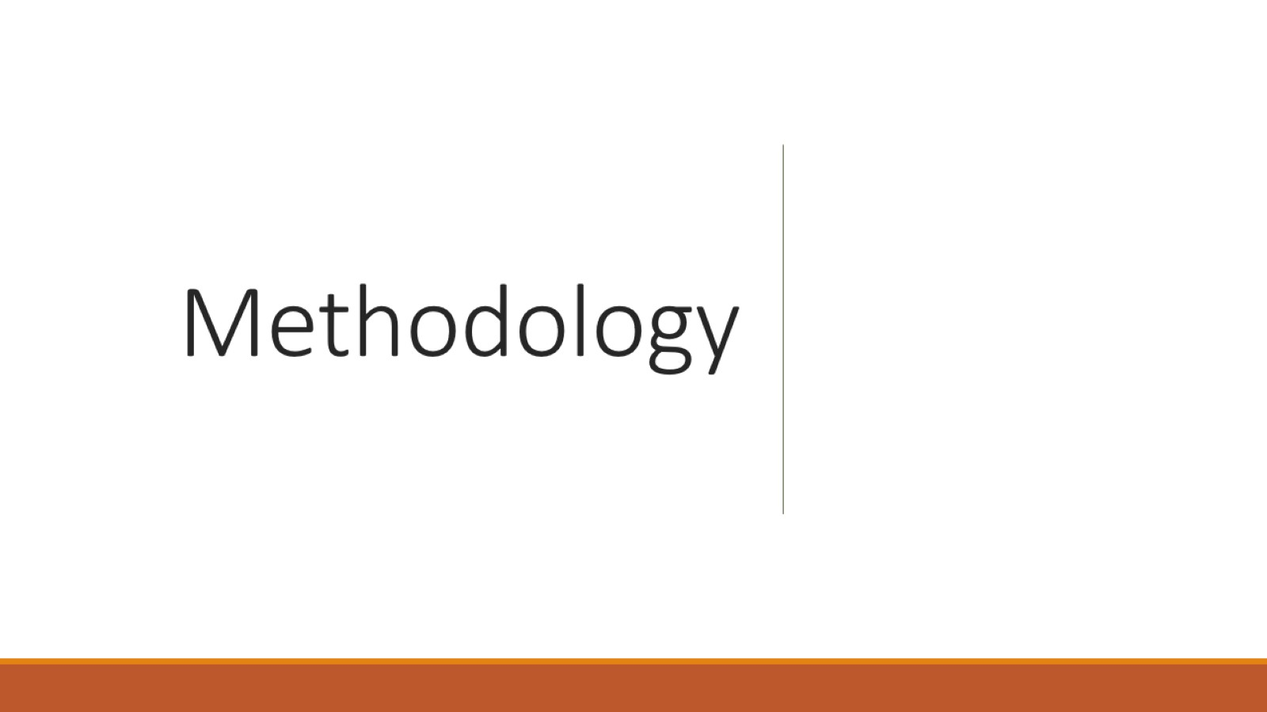
Methodology

Slide 10
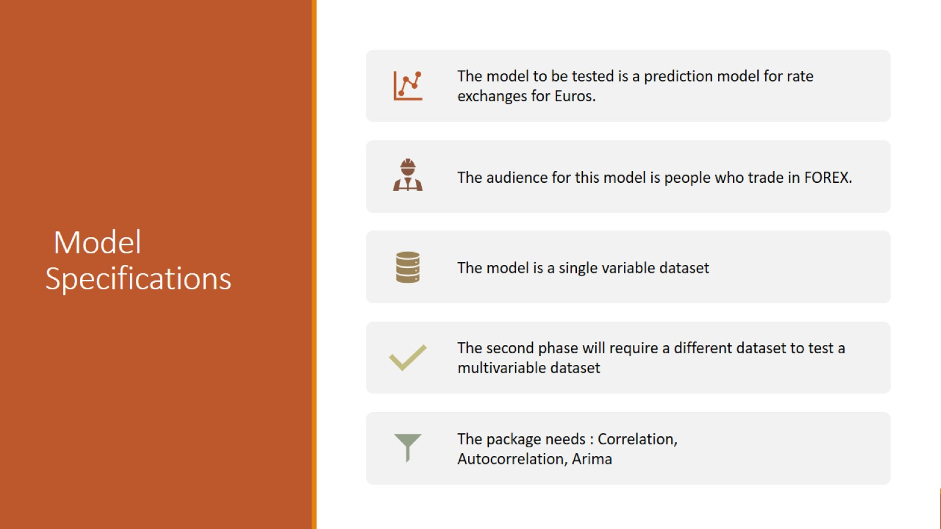
Model Specifications

Slide 11
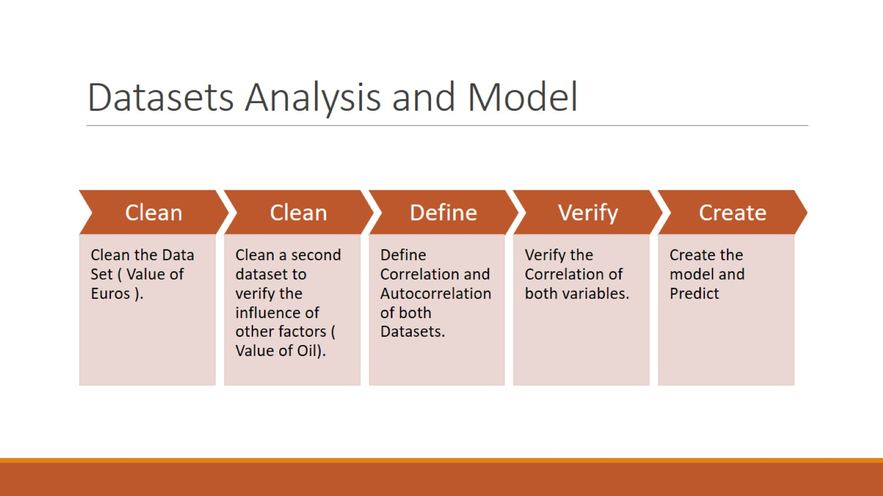
Datasets Analysis and Model

Slide 12
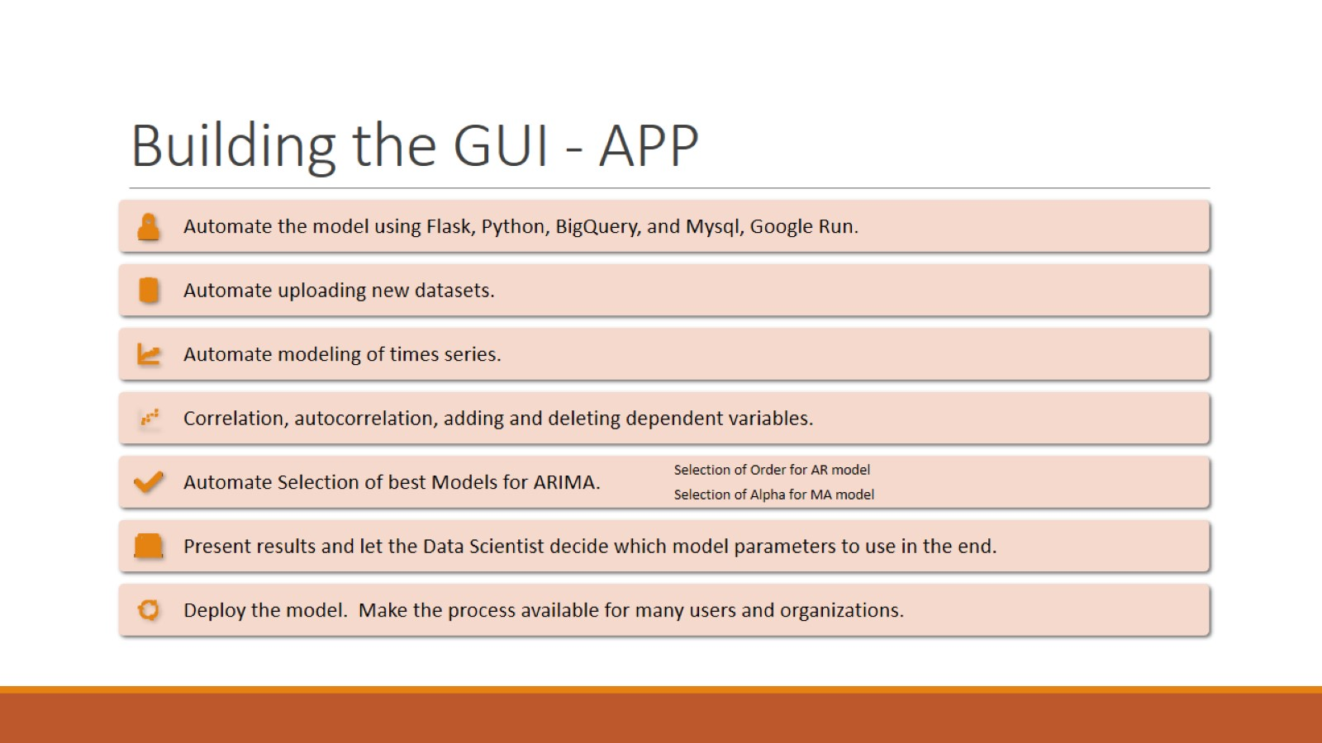
Building the GUI - APP

Slide 13
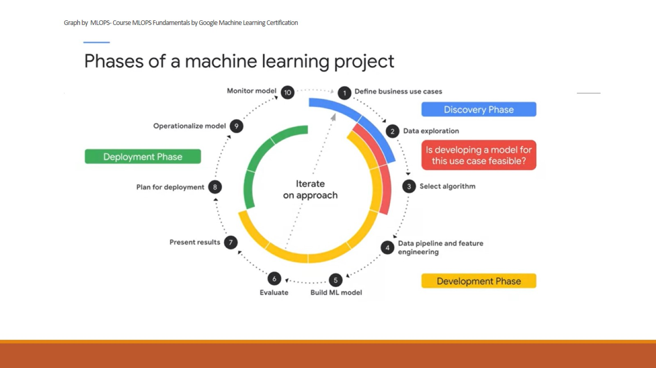
Graph by MLOPS- Course MLOPS Fundamentals by Google Machine Learning Certification

Slide 14
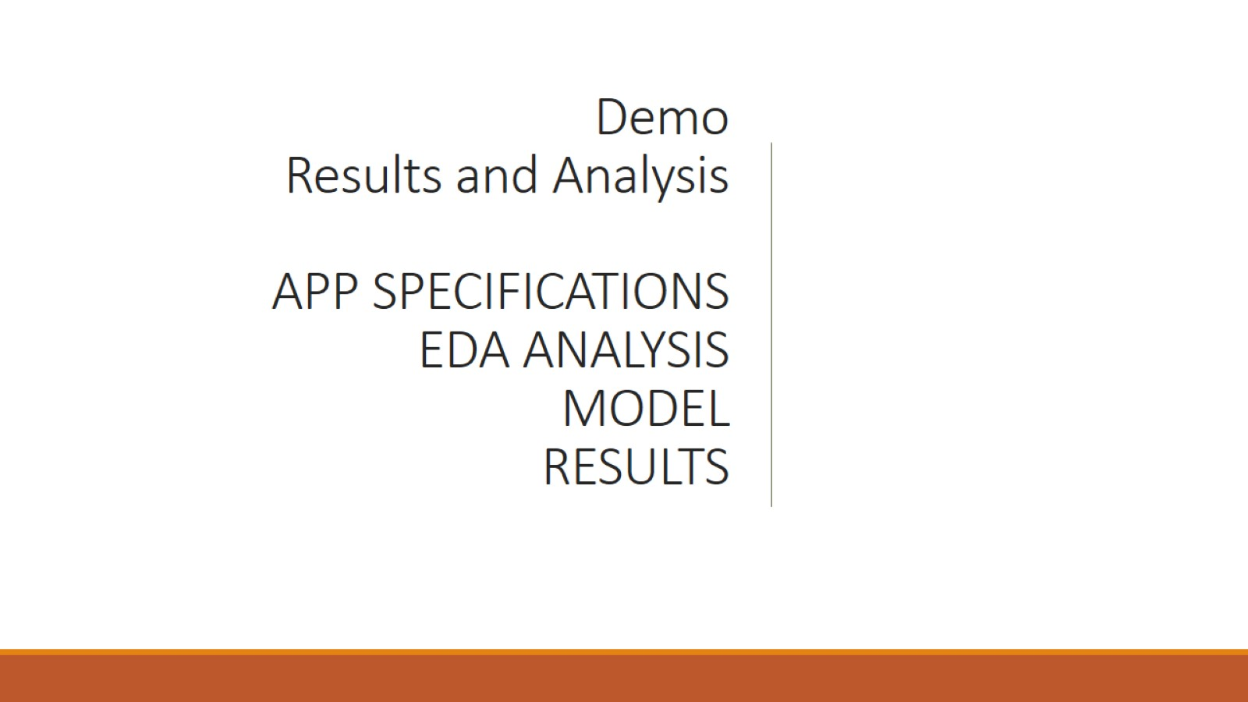
Demo
Results and Analysis
APP SPECIFICATIONS
EDA ANALYSIS
MODEL
RESULTS

Slide 15
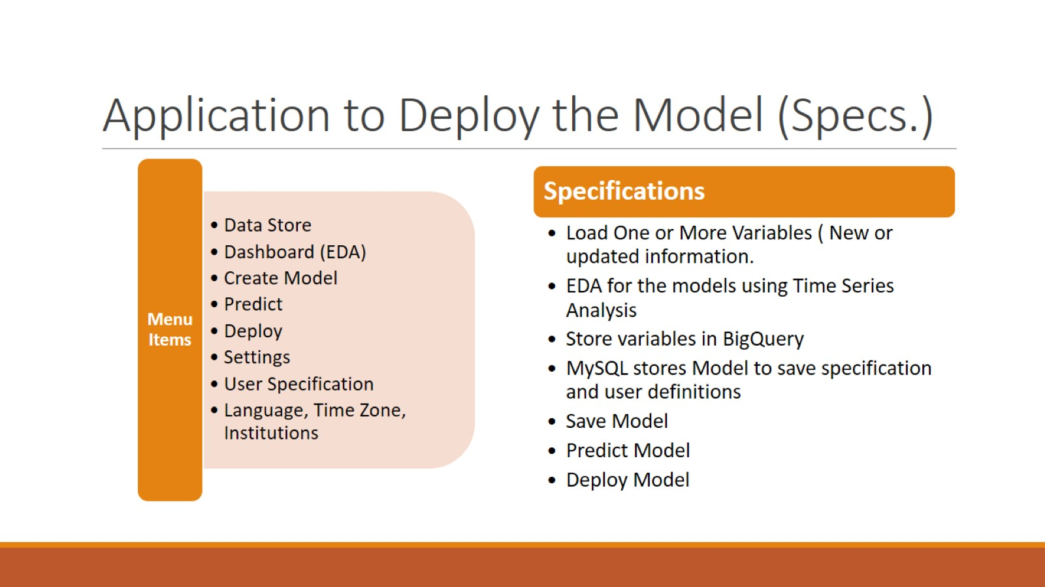
Application to Deploy the Model (Specs.)

Slide 16
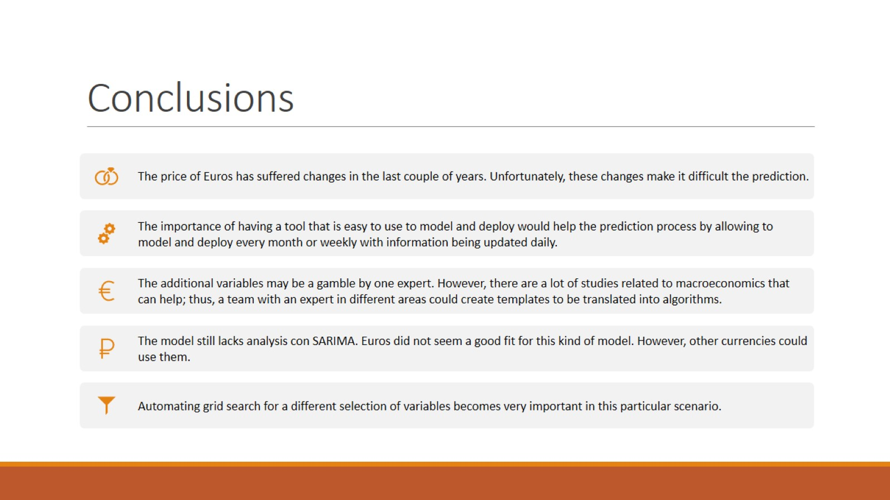
Conclusions

Slide 17

Take Aways

Slide 18

One last thought

